Slide 1
Assignment 3
Svetlana Koroteeva ID: 300432399
AIML 427 - Big Data
Personal disorders classifiers
based on NESARC data

Slide 2
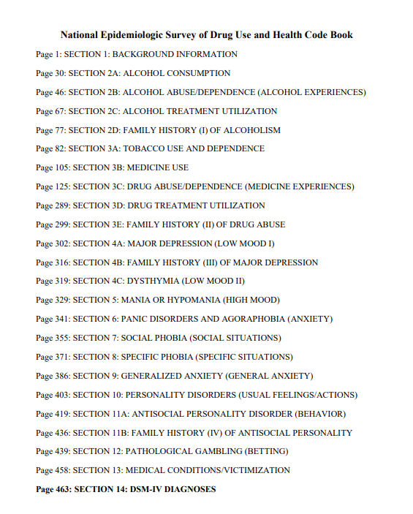

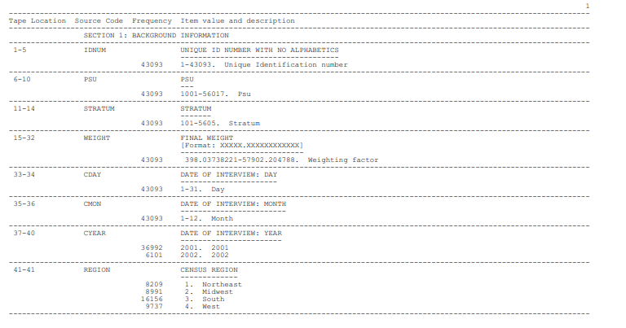
ABOUT DATASET

Slide 3
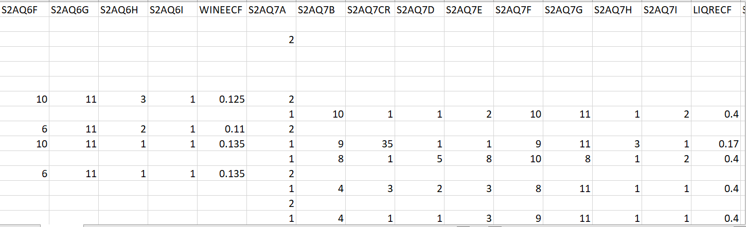
DATASET specifics and problems
43094 instances
Categorical values
Blank or populated with 9,99,999 values
Sometimes several columns represent a class
50.0% missing data in 2183 features from 3008

Slide 4
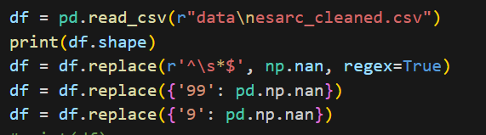
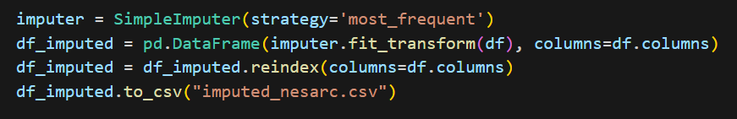
DATASET CLEANING and PREPARING
652 columns left after deleting those columns which have missing data more then 30%

Slide 5
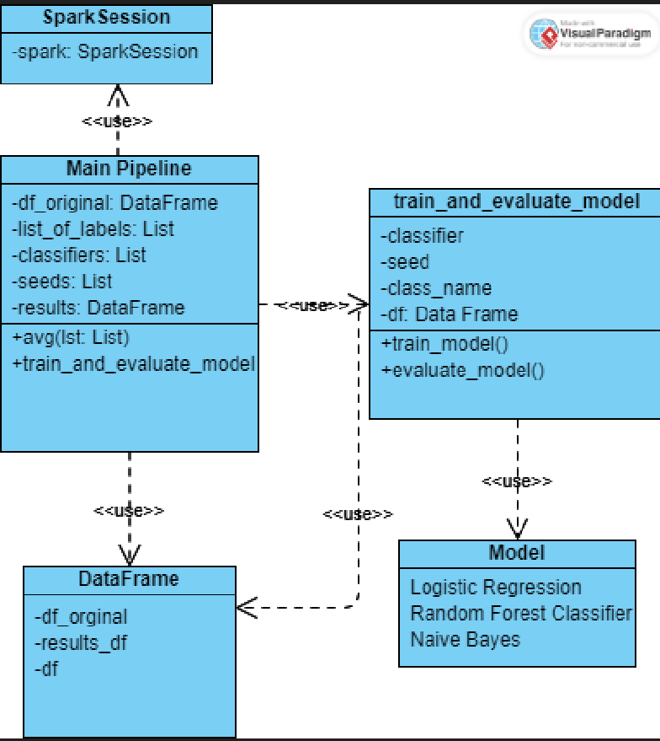
Baseline model
Accuracy 100%?

Slide 6
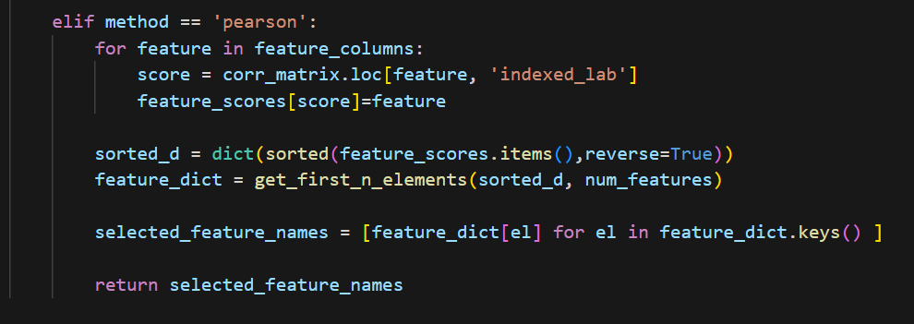
Feature selection
362 columns left
Class | Features
AVOIDPDX2 | DEPPDDX2, S1Q211, S1Q212, S1Q16, DOBY, S1Q20, MARITAL, S1Q14C4, S1Q7A9, SPOUSE
DEPPDDX2 | AVOIDPDX2, S1Q16, S1Q212, S1Q211, S1Q14C4, S1Q20, S1Q7A1, S1Q8A, S3EQ8B, S3EQ8C
OBCOMDX2 | S1Q211, S1Q212, S1Q6A, S1Q7A9, DOBY, S4BQ11, S1Q20, S1Q14C1, S1Q131, S4BQ7C
DEP | S1Q211, S1Q212, S1Q16, S1Q20, SEX, S4BQ11, S4BQ7C, S1Q7A1, S4BQ12, S4BQ7B
PAN | S1Q211, S1Q212, S1Q16, S1Q20, SEX, S1Q7A9, S1Q1D3, S1Q7A1, S4BQ11, S11BQ11
AGORA | S1Q211, S1Q212, S1Q16, S1Q20, SEX, S1Q7A9, S1Q7A1, S2AQ16B, S4BQ11, S4BQ7C
SPECPHOB | SEX, S1Q211, S1Q212, S1Q16, S1Q20, S4BQ11, S1Q7A9, DOBY, S4BQ7C, S1Q14C1
ANX | DEP, PARADX2, S1Q211, S1Q212, S1Q20, S1Q16, SEX, S1Q1C, S1Q7A1, S1Q7A9

Slide 7
Baseline model
Train and evaluate the model pseudocode
Start measuring the time.
Split the dataset into training and test sets.
(Clean and impute test and train data) #not implemented yet
Create an instance of classifier
Create a pipeline and add the classifier.
Create Vector assembler object
Transform training and test data
Create a Scaler object #this part is for normalizing script only
Fit a scaler on the training data
Transform training and test data with scaler
Fit the pipeline on the training data
Use the trained model to make predictions.
Calculate the accuracy of the training predictions
Use the trained model to make predictions on test data.
Calculate the accuracy of the test predictions
Stop measuring time and calculate the running time.
Return the training accuracy, test accuracy, and running time.

Slide 8
Baseline model performance results
Classifier | Class | Training Accuracy | Test Accuracy | Running Time
LogisticRegression | CONDUCTONLY | 0.990667586 | 0.989592767 | 112.1902
RandomForestClassifier | CONDUCTONLY | 0.99051317 | 0.990032873 | 5.487722
NaiveBayes | CONDUCTONLY | 0.656224096 | 0.655213452 | 1.641517
LogisticRegression | ANTISOCDX2 | 0.969575959 | 0.967224738 | 6.093356
RandomForestClassifier | ANTISOCDX2 | 0.967115992 | 0.967691178 | 5.507843
NaiveBayes | ANTISOCDX2 | 0.377409928 | 0.377975363 | 1.567013
LogisticRegression | AVOIDPDX2 | 0.981357332 | 0.978460826 | 5.791655
RandomForestClassifier | AVOIDPDX2 | 0.976702169 | 0.978020777 | 5.373419
NaiveBayes | AVOIDPDX2 | 0.48252516 | 0.478837491 | 1.602829
LogisticRegression | DEPPDDX2 | 0.997473886 | 0.993372754 | 5.482821
RandomForestClassifier | DEPPDDX2 | 0.995102155 | 0.995391874 | 5.322338
NaiveBayes | DEPPDDX2 | 0.579333386 | 0.573646909 | 1.564391
LogisticRegression | OBCOMDX2 | 0.929256918 | 0.928884067 | 63.72542
RandomForestClassifier | OBCOMDX2 | 0.924017117 | 0.925880876 | 5.896053
NaiveBayes | OBCOMDX2 | 0.566107277 | 0.568573574 | 1.557272
LogisticRegression | PARADX2 | 0.960453252 | 0.956274904 | 31.97484

Slide 9
Normalized data model
(Applied for both training and test data)

Slide 10
Why scaling did not work?
.
Data is in the same magnitude
Data is categorical

Slide 11
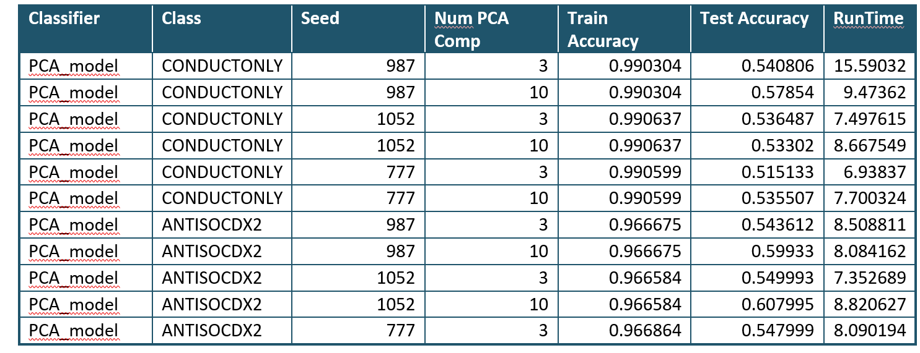
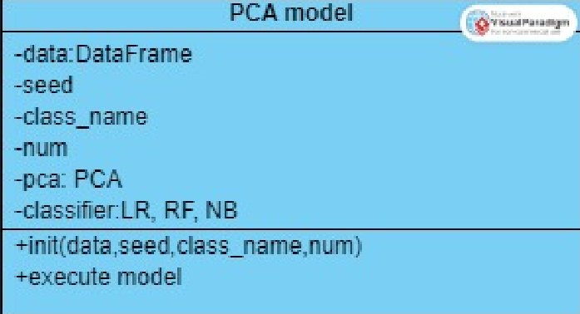
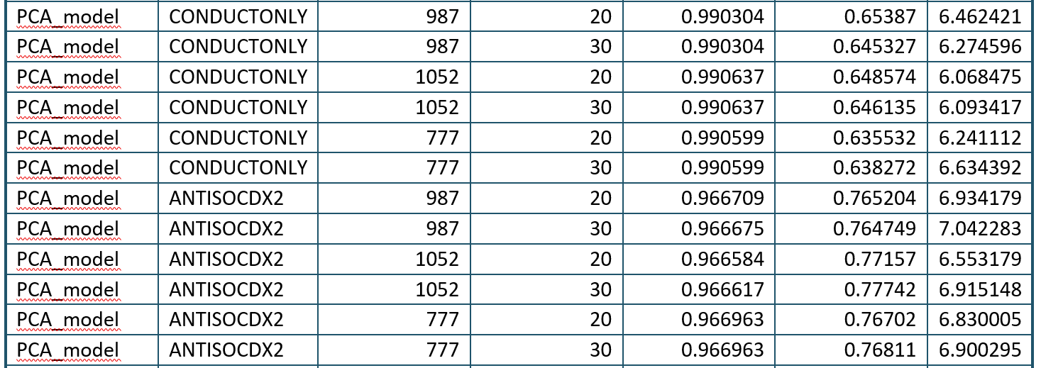
PCA model

Slide 12
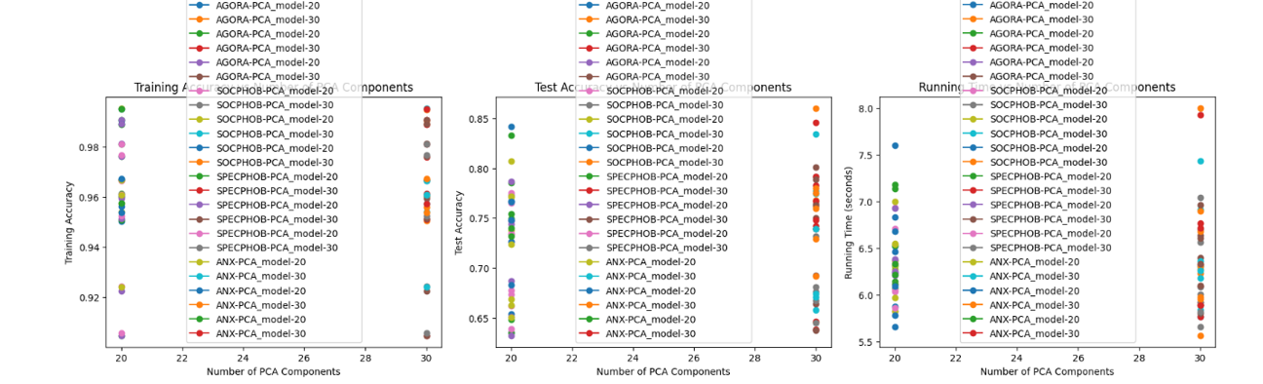
MORE PCA

Slide 13
Why PCA did not work
Categorical data
Non-linear relationships
Outliers?

Slide 14
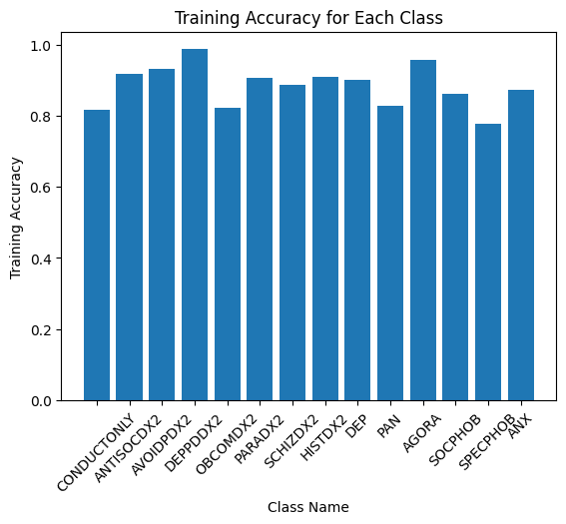
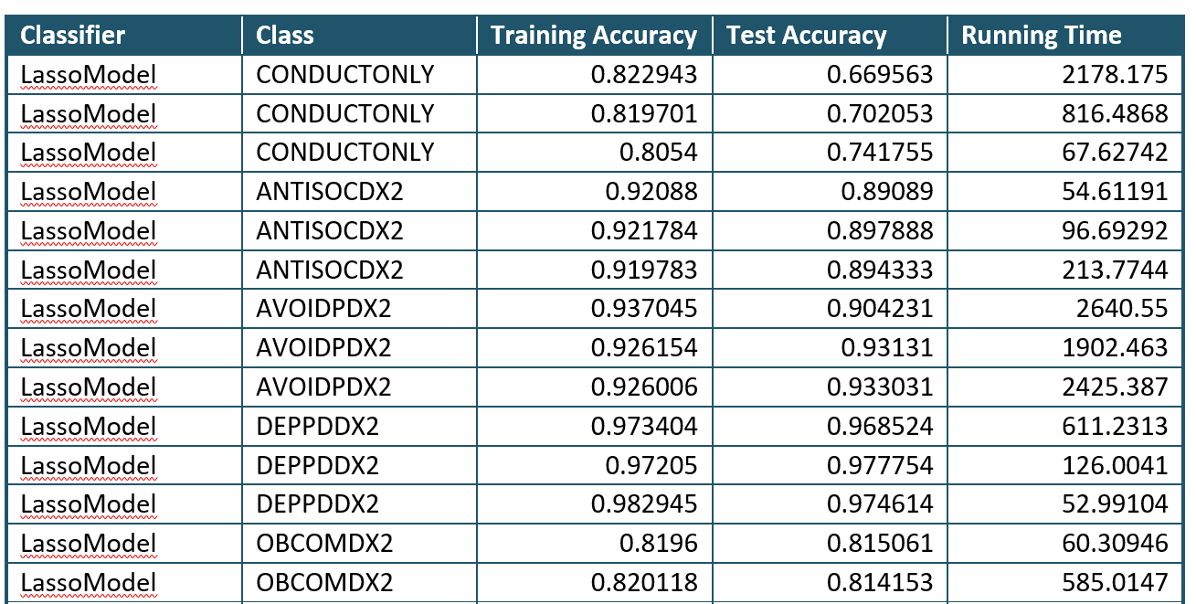
Further trials: Lasso
unbalanced data

Slide 15
References
National Epidemiologic Survey on Alcohol and Related Conditions-III (NESARC-III) | National Institute on Alcohol Abuse and Alcoholism (NIAAA) (nih.gov) - about NESARC dataset for the Q1
wesleyan-machine-learning/data at master · radumas/wesleyan-machine-learning (github.com) – source for download nesarc_pds.csv dataset for Q1
DSM-IV codes - Wikipedia - Diagnostic and Statistical Manual of Mental Disorders, 4th Edition
PySpark Lasso Regression – Building, Tuning, and Evaluating Lasso Regression with PySpark MLlib - Machine Learning Plus – Lasso regression with pyspark, making vector from features
Correlation — PySpark 3.4.0 documentation (apache.org) – Ranking with correlation: chi-square
PCA — PySpark 3.4.0 documentation (apache.org) -PCA
Visual Paradigm Online (visual-paradigm.com)

